Slide 1
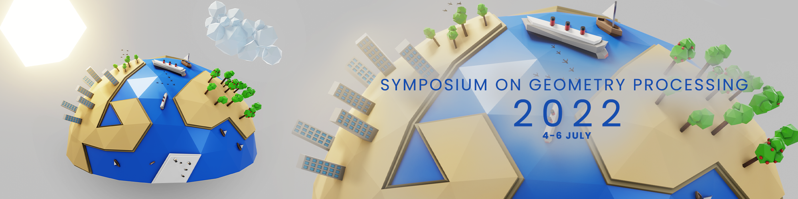

Slide 2

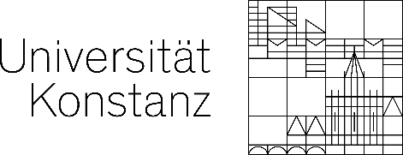
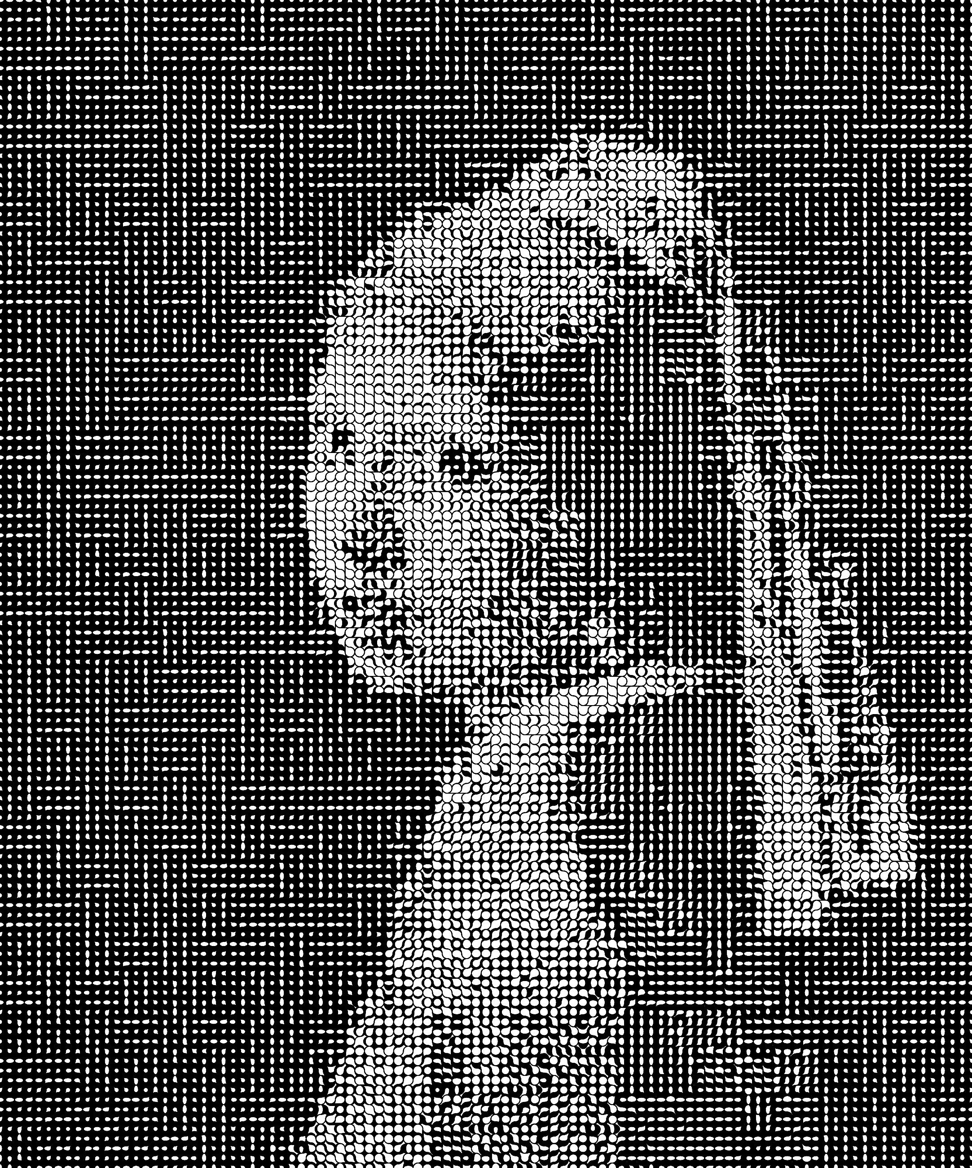
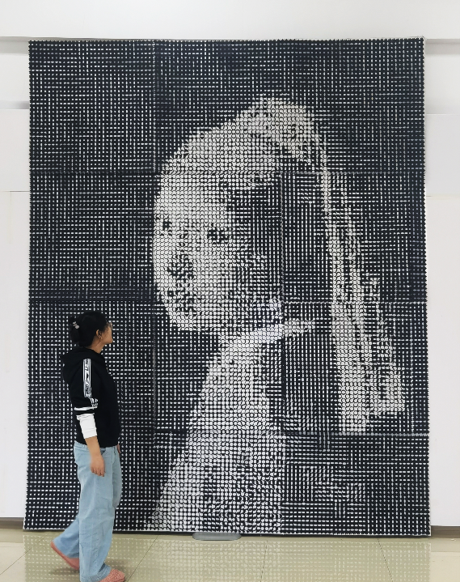
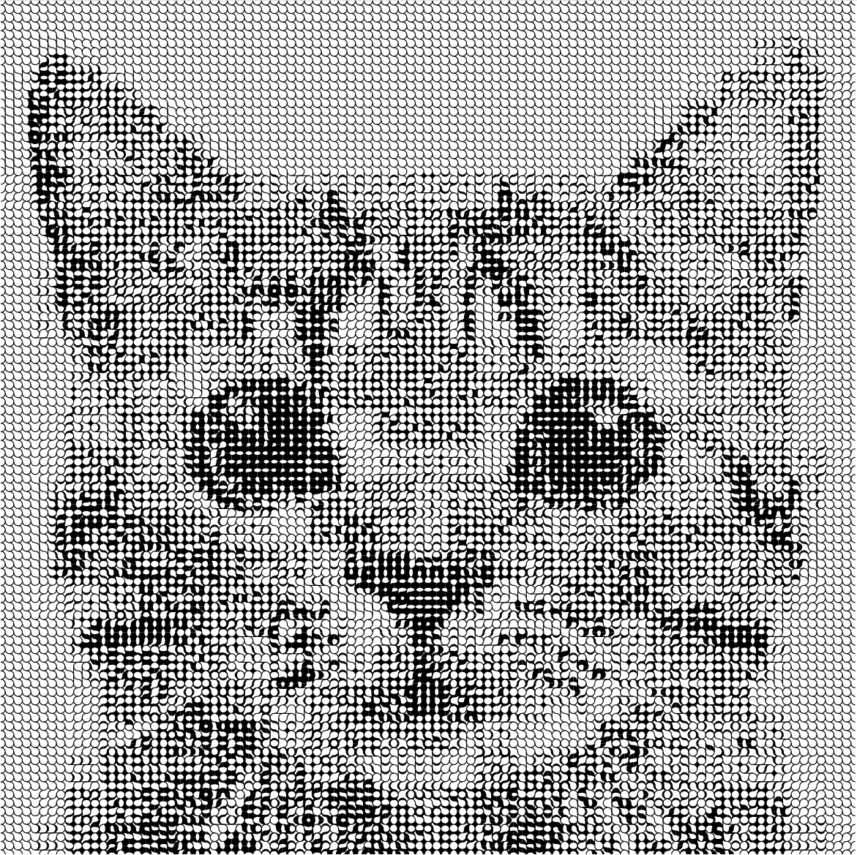
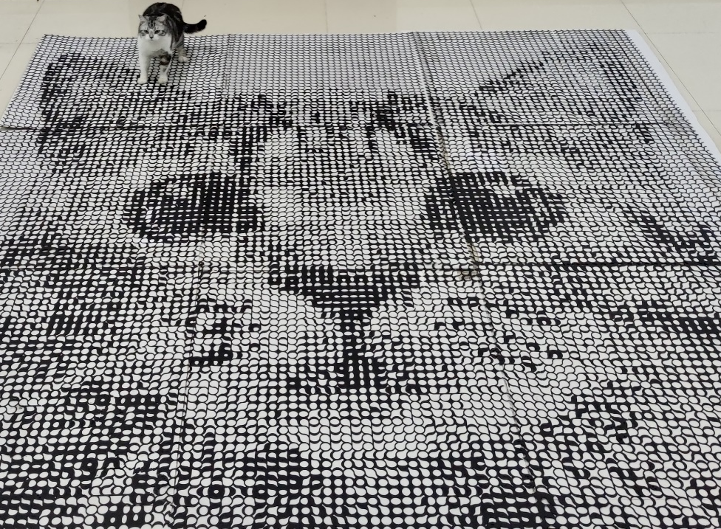

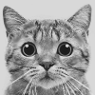
Fabricable Multi-Scale Wang Tiles
Xiaokang Liu¹ Chenran Li¹ Lin Lu^{1*} Oliver Deussen² Changhe Tu¹
¹ Shandong University
² University of Konstanz
Notes:
Hello everyone.
My name is Liu Xiaokang from Shandong University.
It’s my pleasure to present our work “Fabricable Multi-Scale Wang Tiles”
It is a joint work by Li Chenran, Lu Lin, and Tu Changhe from Shandong University,
And Oliver Deussen from University of Konstanz.

Slide 3
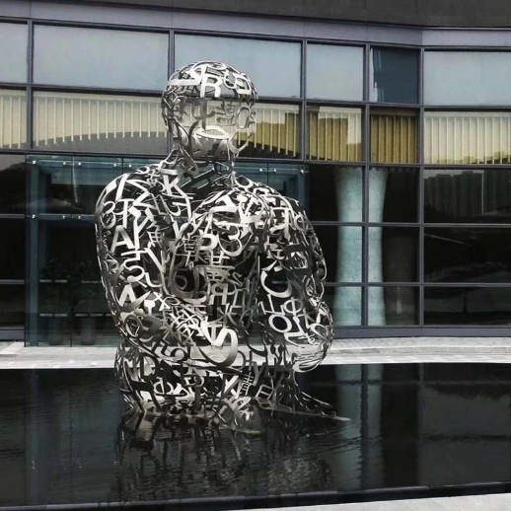
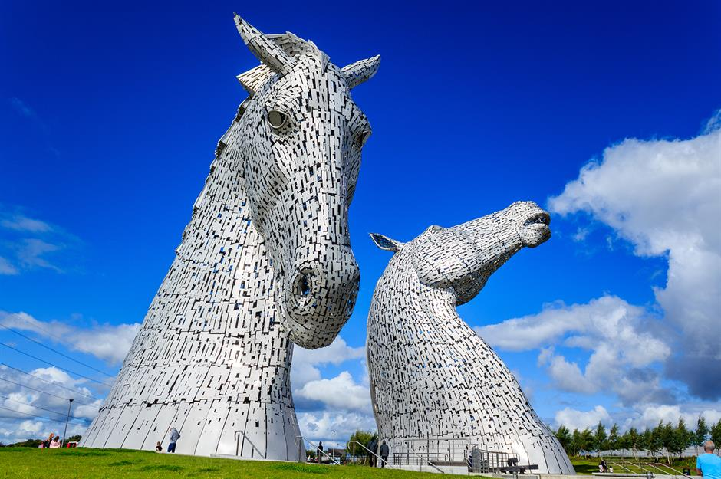
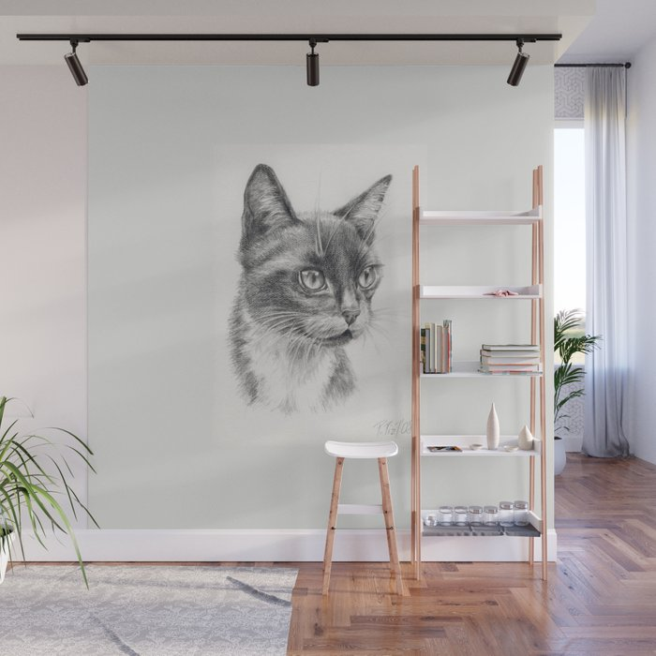
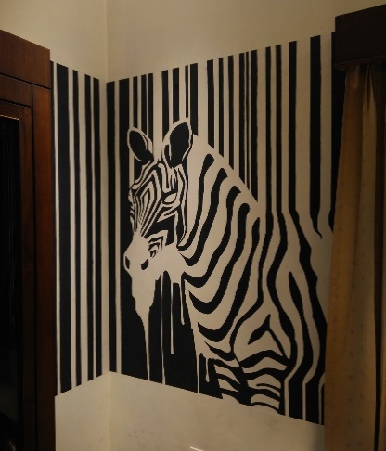
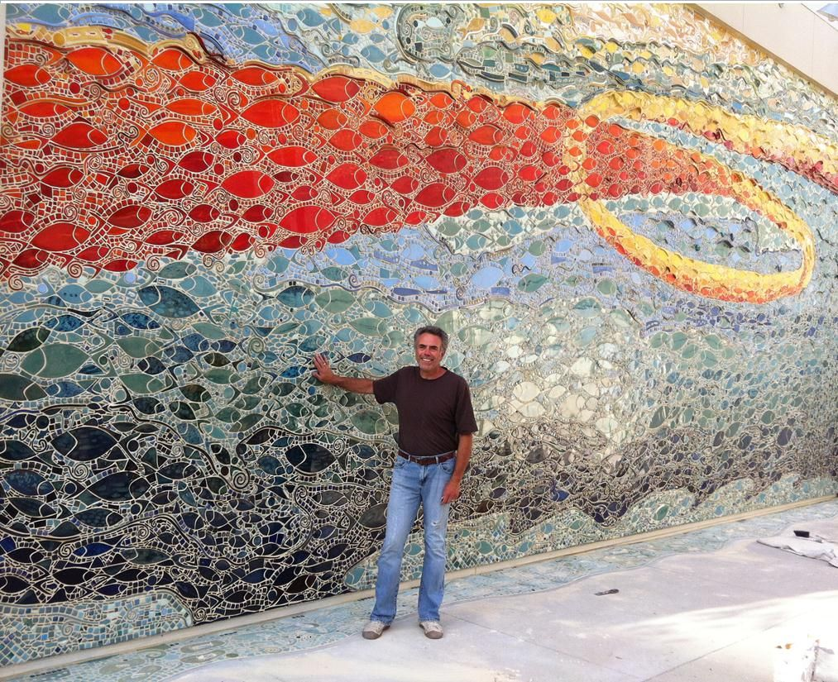
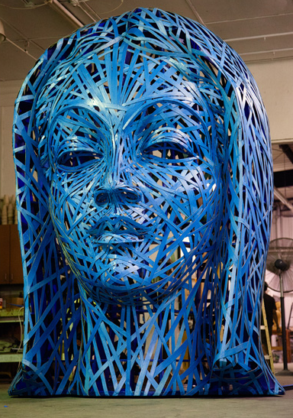
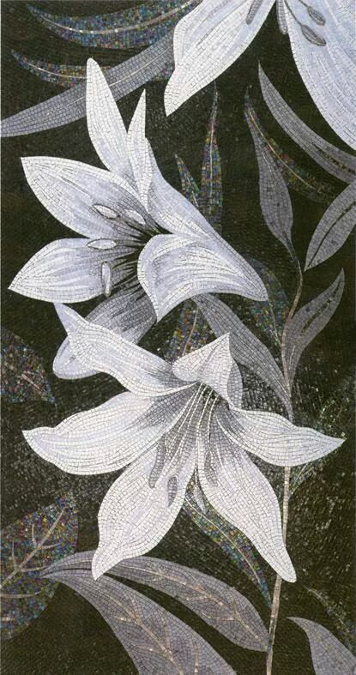
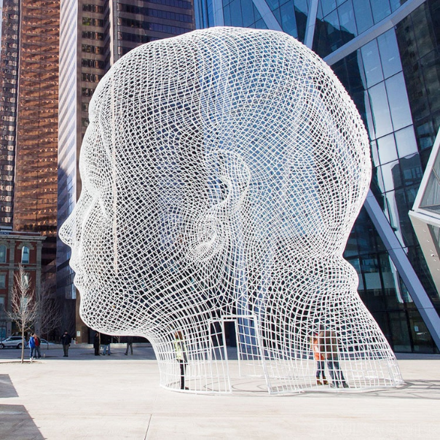
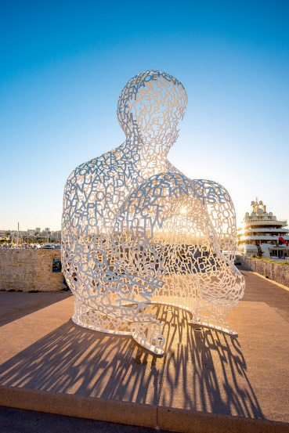
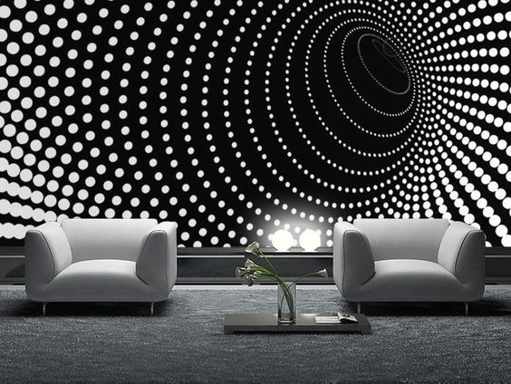
Inspirations — Large-scale customized art
Large-scale manufacturing is tedious and requires high assembling expertise.
Hollow statues
Murals & wall decoration
Assembled artwork
All images are from Internet.
Notes:
Large-scale customized design is a popular art form, including the
[click] large-scale hollow statues composed of rods and pieces, have more beautiful appearance and a transparent sense of hierarchy
[click] Black and white mural and wall decoration, can express complex structures or patterns with different gray through the two colors.
[click] There are also assembled artworks, such as slatted models, mosaic tiling, and such other large-scale creation assembled from small templates
[click] But such manufacturing is tedious and requires high assembling expertise.

Slide 4
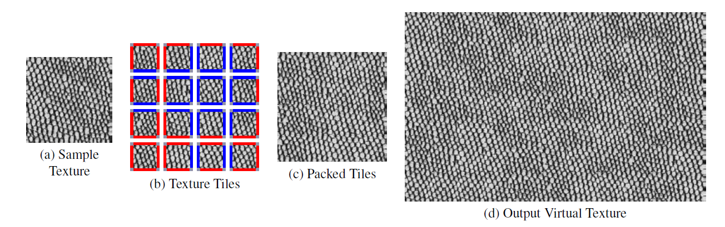
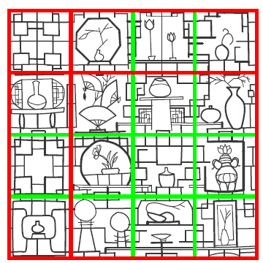
Our goal
To efficiently generate large-scale artwork with fine details using a few types of small-scale pre-fabricated tiles.
First, we need a set of tiles:
Wang tile:
A puzzle system with color-coded squares;
Arranged side by side with matching colors;
Without rotating or reflecting them;
Single scale.
Fabricable;
Single-connected;
Boundary-aligned;
Presenting various densities;
Compact types of set;
Multi-scale for efficient tiling.
[Wei’04]
[Bian’18]
Notes:
[click] How to efficiently generate large-scale artwork with fine details using a few types of small-scale pre-fabricated tiles?
To solve this problem,
[click] we need a set of tiles which is [click] fabricable, [click] single-connected and [click] boundary-aligned, [click] and it can present various density and
[click] have compact types, [click] finally, is multi-scale for quick tiling.
[click] We think Wang tile is a solution. [click] It is a puzzle system with color-coded squares, [click] so it is easily designed to be fabricable and single-connected and have various interior with different densities.
[click] Wang tile is arranged side by side with matching colors, thus is boundary-aligned.
[click] However, traditional wang tiles cannot rotate, [click] means no way to compress the quantity.
[click] Moreover, it is just single scale.

Slide 5
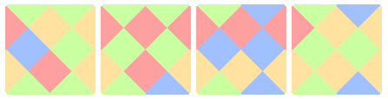
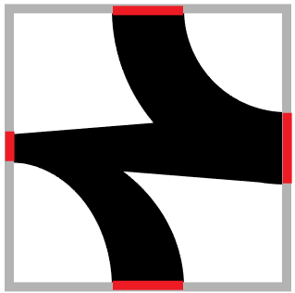
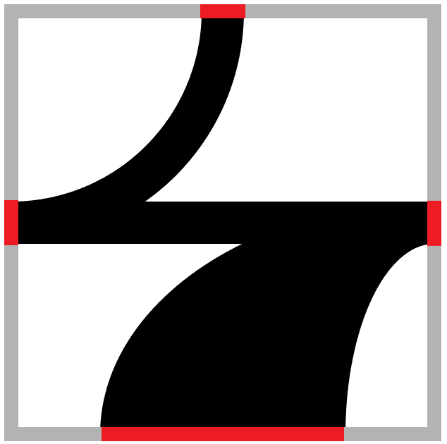
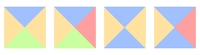
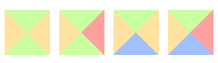
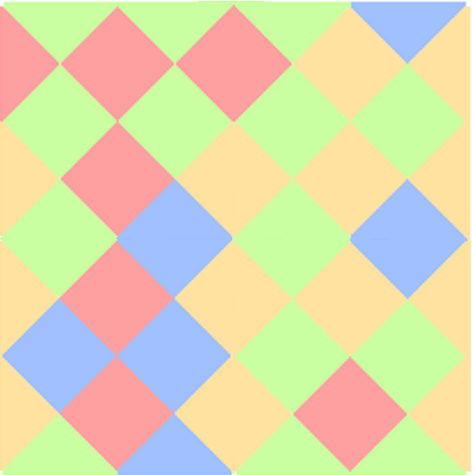
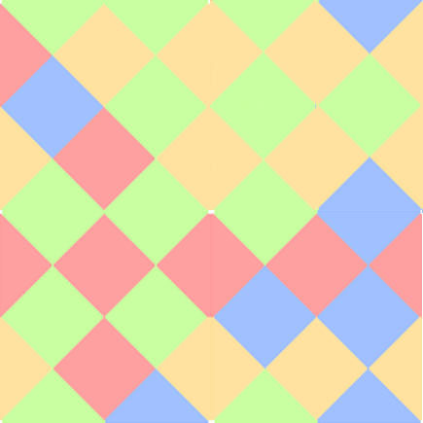


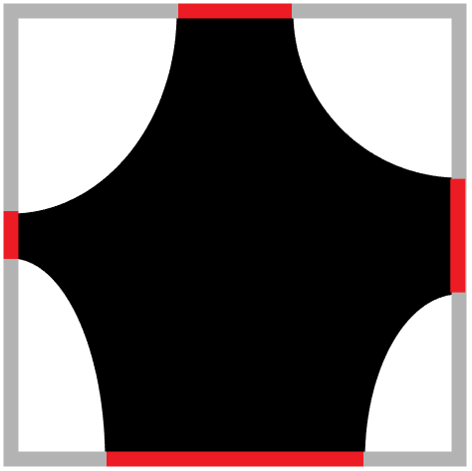

Multi-scale Wang tiles
Wang tiles allowed to rotate
Rotation is a natural operation to enhance the suitability of fabricated tiles, reducing its number of types.
Wang tiles with various densities:
Increase the number of “colors” to improve the precision of density expression, while leading to a combination explosion in the amount of types.
Multi-scale:
Reduce the overall number of pre-fabricated tiles, but increase the amount of types and the density error.
It is conflicting to minimize the type and total number of pre-fabricated tiles while minimizing the density error between the result and the target.
2 x 2 tiles
……
Tiles with various densities
Elementary tiles
4 x 4 tiles
Notes:
Thus, we come up with the concept of multi-scale wang tiles.
[click] First of all it allows wang tiles to rotate, because for fabricated tiles, rotation is a natural operation to enhance the suitability, meanwhile reducing its number of types.
[click] Then, we introduce a model to generate interior patterns with density relative to edges and increase the number of “colors” to improve the precision of density expression, while leading to an combination explosion in the amount of types.
[click] Finally, the usage of multi-scale reduces the overall number of pre-fabricated tiles, but increase the amount of types and the density error.
[click] In summary, we find that It is conflicting to minimize the type and total number of pre-fabricated tiles while minimizing the density error at the same time.

Slide 6
Problem description
Challenges:
Combination explosion of the types of tile due to the pursuit of efficient tiling and fine density details.
Objectives:
A method to generate representative multi-scale Wang tiles minimizing the amount of types and the total number of pre-fabricated tiles, meanwhile minimizing the density error.
An efficient algorithm to tile a given image hierarchically using our tiles.
Constraints:
Manufacturing constraints: tiles should be single-connected and the smallest part should meet minimal manufacturing requirements.
Notes:
So the problem we have to solve is clear.
[click] The biggest challenge is combination explosion of the types of tile due to the pursuit of efficient tiling and fine density details.
[click] And our objectives are finding a method to generate representative multi-scale Wang tiles minimizing the amount of types and the total number of pre-fabricated tiles, meanwhile minimizing the density error, [click] as well as an efficient algorithm to tile a given image hierarchically using our tiles.
[click] Our approach has to satisfy manufacturing constraints that the tiles should be single-connected and the smallest part should meet minimal manufacturing requirements.

Slide 7
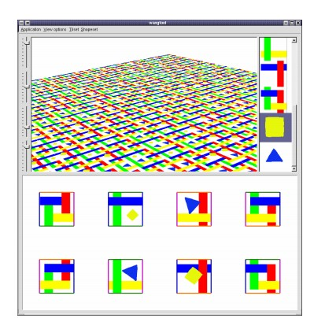
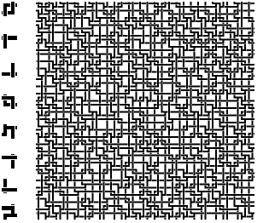
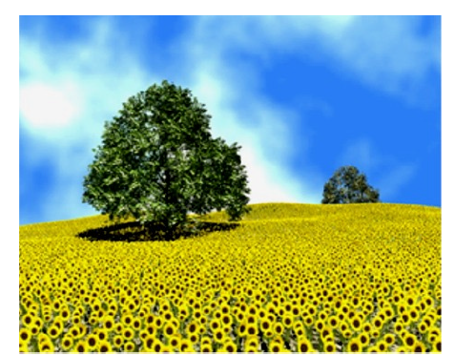
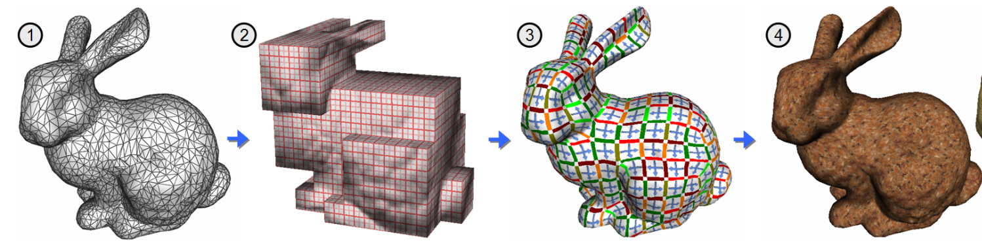
Related Work — Wang tiles for image & texture synthesizing
[Cohen et al. Wang tiles for image and texture generation. TOG, 2003]
[Wei, Li-Yi. Tile-based texture mapping on graphics hardware. SIGGRAPH. 2004.]
Inefficient when tiling a large target tile by tile;
Has no ability to express various densities.
[Chi-Wing Fu and Man-Kang Leung. Texture Tiling on Arbitrary Topological Surfaces Using Wang Tiles. EGSR 2005.]
Notes:
Traditional wang tiles is mainly used for image and texture synthesizing.
[click] But it is inefficient when tiling a large target tile by tile, and has no ability to express various densities.

Slide 8
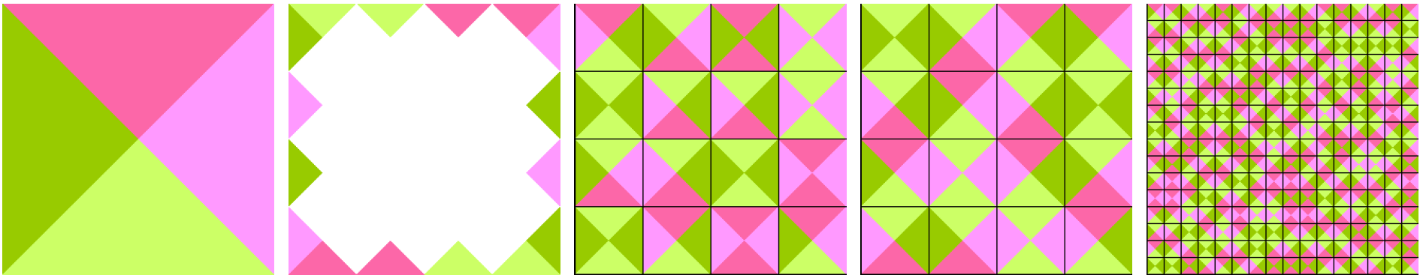
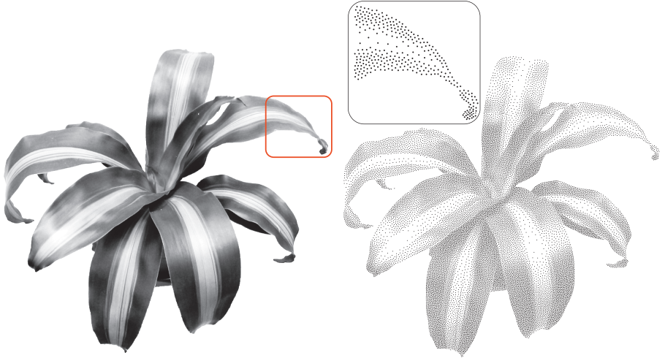
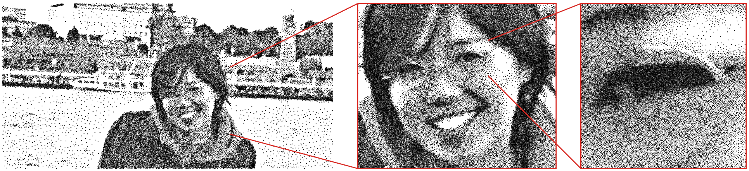
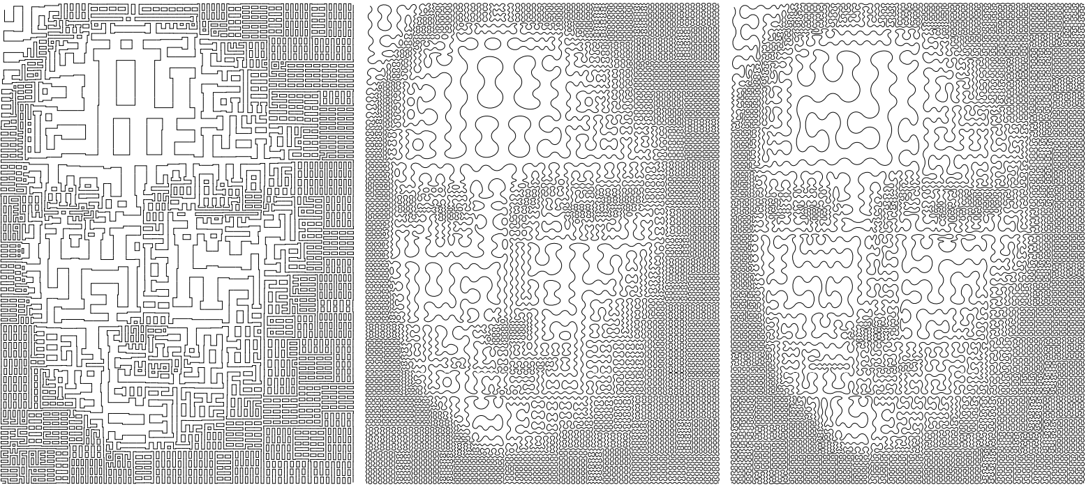
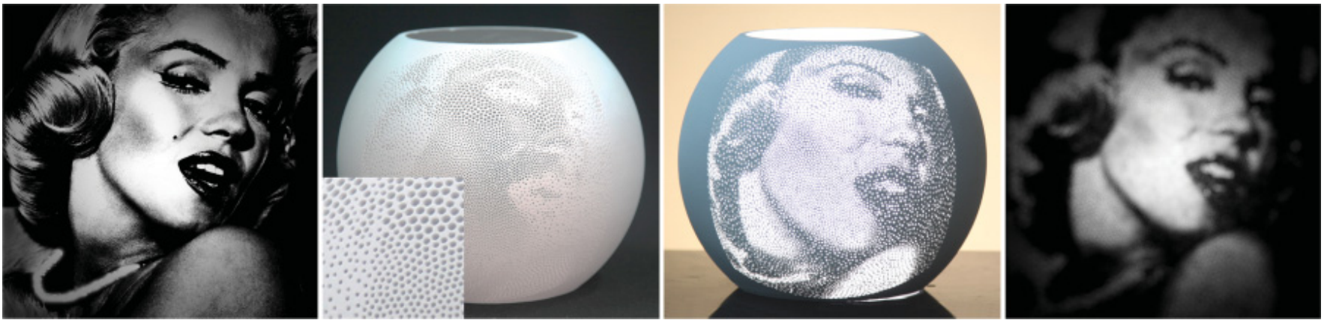
Related Work — Halftoning & stippling
[Kopf J, et al. Recursive Wang tiles for real-time blue noise. SIGGRAPH 2006]
[De Goes F, et al. Blue noise through optimal transport. TOG 2012]
Not suitable for large-scale fabrication
[Ahmed A G M. Modular line-based halftoning via recursive division. NPAR 2014]
[Zhao H, et al. Printed perforated lampshades for continuous projective images. TOG 2016]
Notes:
[click] Halftoning is a classic technique used in traditional paper printing and digital displays, producing well-distributed point sets.
And recent research on halftone has expanded to [click] stylized lines and [click] 3D digital halftoning.
[click] but their work is not suitable for large-scale fabrication.

Slide 9
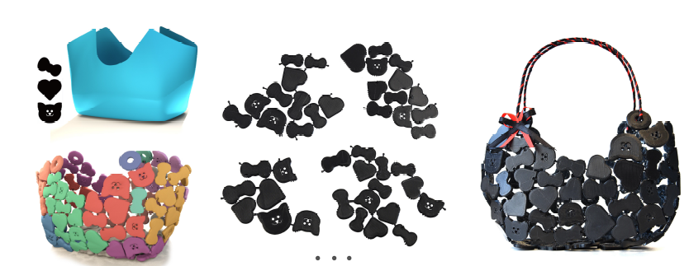
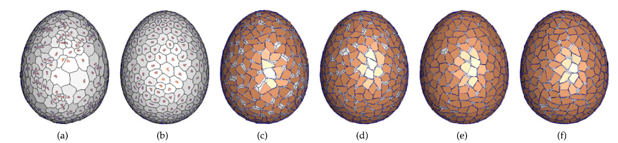
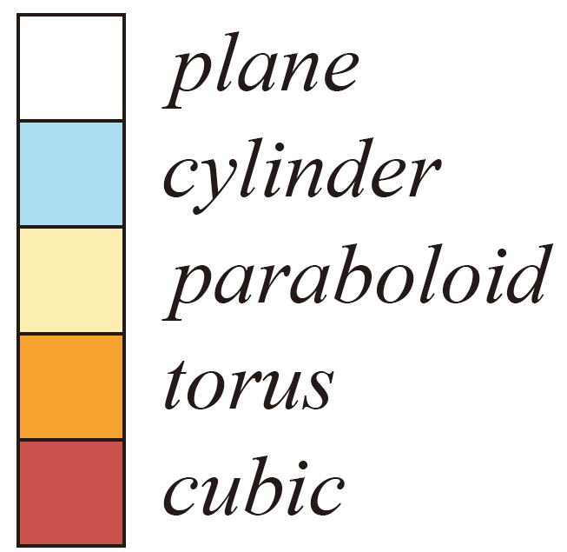
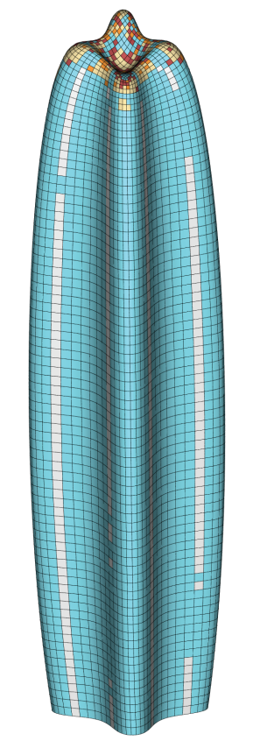
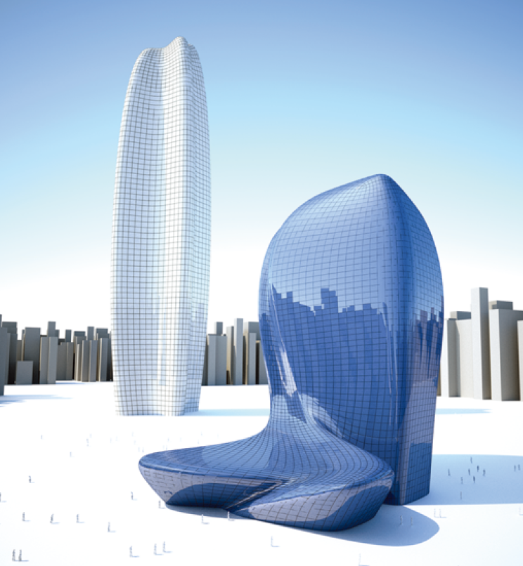
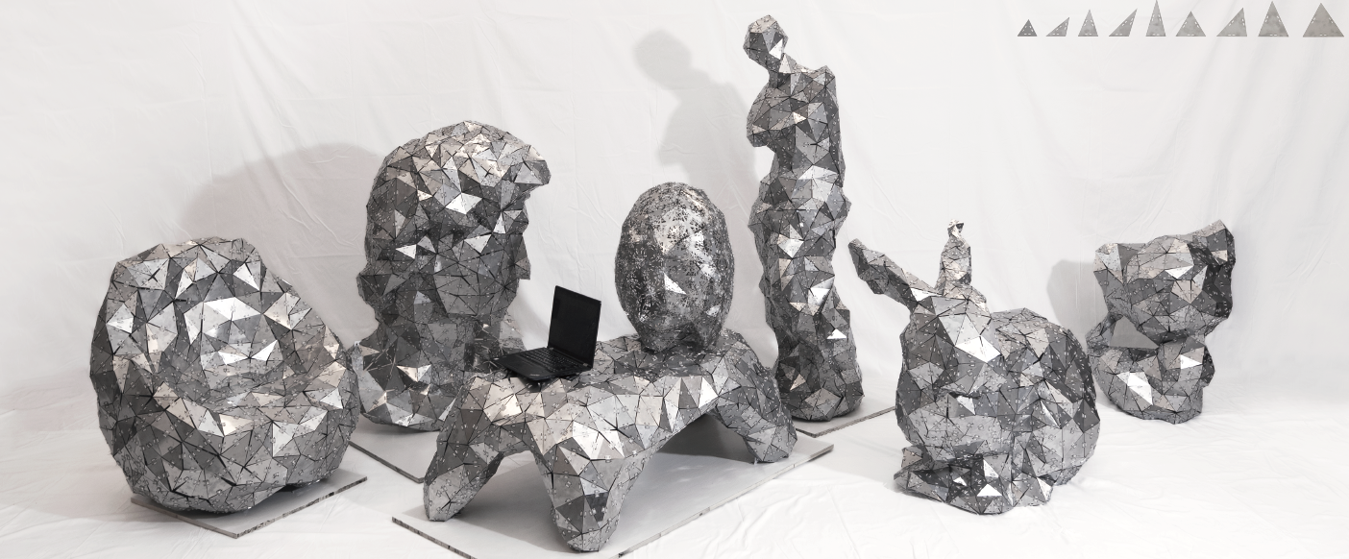
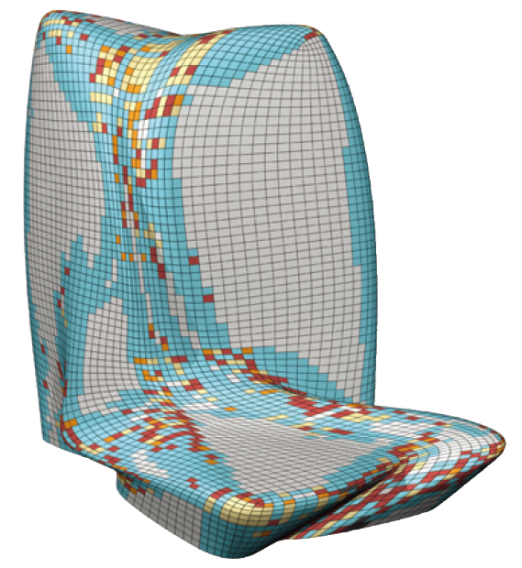
Related Work — Mosaic tiling & assembled models
Requires a large number of different small tiles, leading to a huge consumption of production and assembly.
[Hu, et al. Surface mosaic synthesis with irregular tiles. TVCG 2015]
[Chen, et al. Fabricable tile decors. TOG 2017]
[Eigensatz M, et al. Paneling architectural freeform surfaces. SIGGRAPH 2010]
[Liu, et al. Modeling and fabrication with specified discrete equivalence classes. TOG 2021]
Notes:
Assembling from small components is a [click] common way to generate large scale objects.
Such as Mosaic tiling, [click] but it requires a large number of different small tiles, leading to a huge consumption of production and assembly.
[click] Assembled models is also a popular work.
Similar to their work, our method tiles a density map using pre-defined multi-scale Wang tiles.

Slide 10
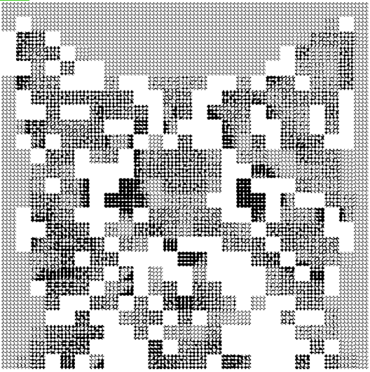
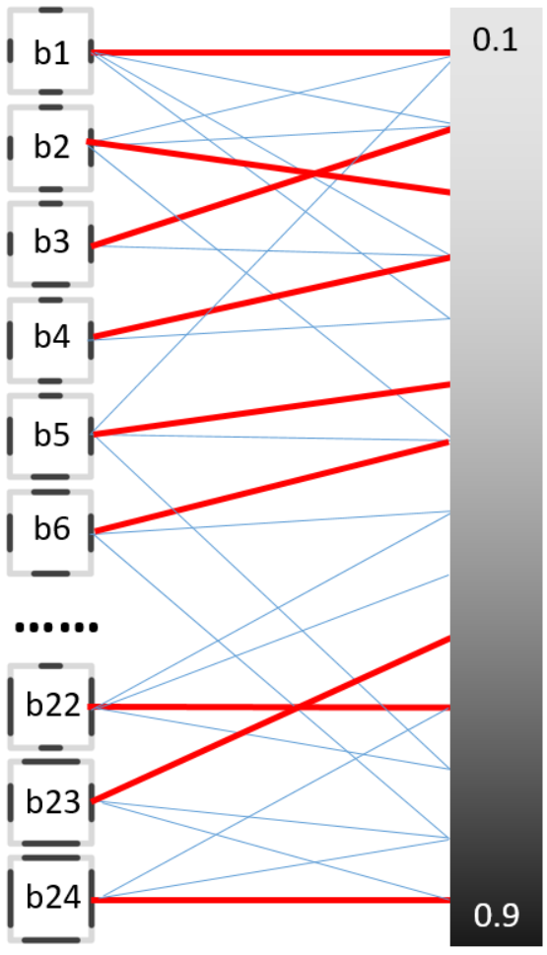

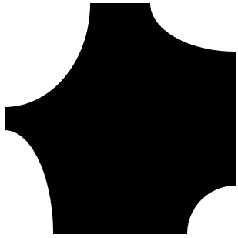

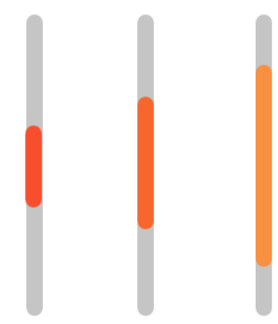
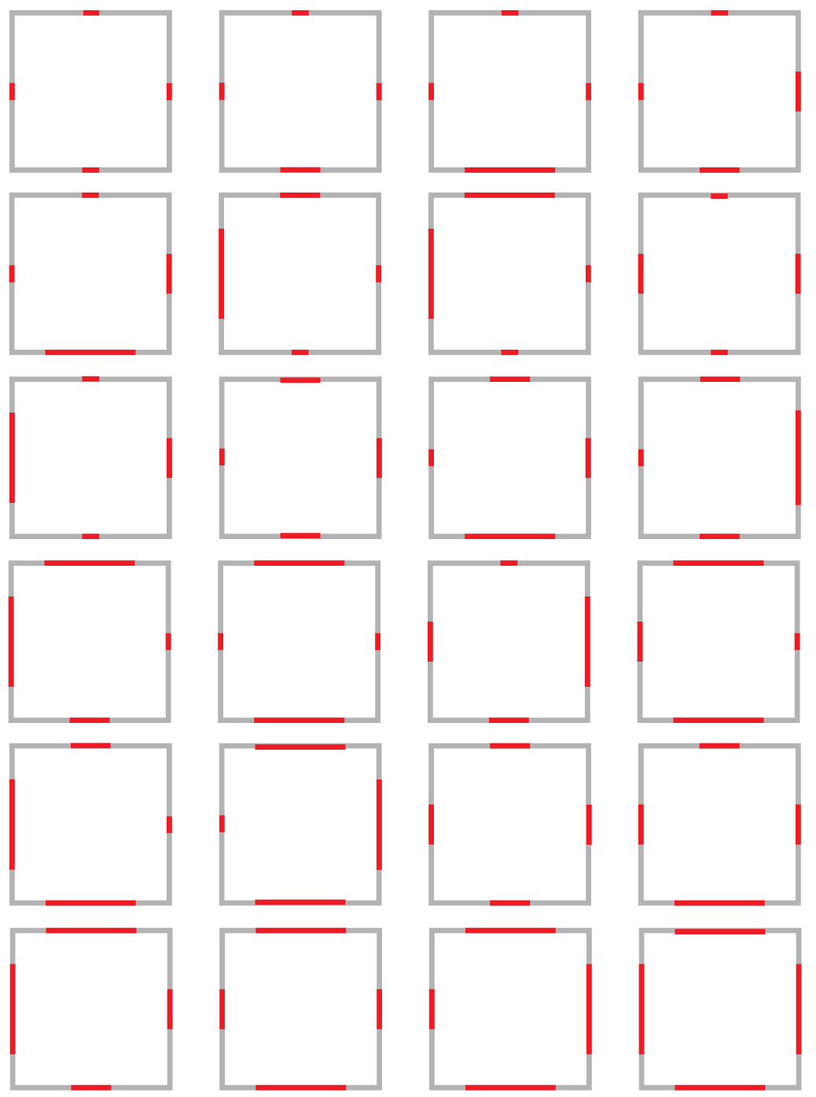
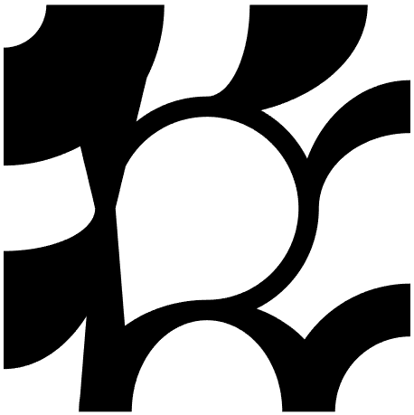


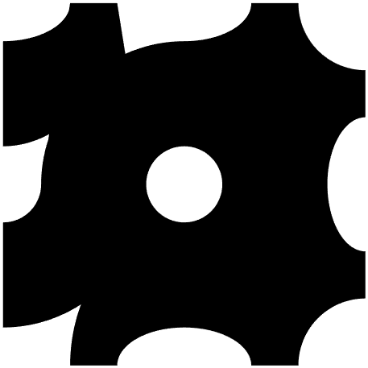






Overview
Terminology：RES: Representative elementary tile set; RCS: Representative combined tile set
……
RES
……
……
……
……
RCS
Representative
“colors” & boundaries
Representative tile generation
Hierarchical tiling
Tiling result
Notes:
Here is overview of our method.
[click] First pick representative “colors” and corresponding boundaries.
[click] Then generate representative tile sets by calculate the optimal matching.
[click] Using these tile sets ,we tile a given image hierarchically, [click]obtaining an optimal "half-toning" result.

Slide 11
Overview
……
RES
……
……
……
……
RCS
Representative
“colors” & boundaries
Representative tile generation
Hierarchical tiling
Tiling result
Notes:
First we introduce how to pick representative colors and boundaries.

Slide 12











Representative “colors” & boundaries
For RES (Representative elementary tile set) :
Preset 3 “colors ” to avoid combination explosion while maintain the faithfulness of the density representation.
Pick representative boundaries by eliminating rotationally symmetric ones.
Target density:
[0.1, 0.9]
0.1
$$l_{min}=0.034$$
$3^{4}=81$ boundaries
0.5
$$l_{mid}=0.26$$
0.9
$$l_{max}=0.627$$
Calculate $l$ using bisection method
Eliminate redundant boundaries
24 representative boundaries
Notes:
For res, [click] we Preset 3 “colors ” to avoid combination explosion while maintain the faithfulness of the density representation.
[click] The length of the color is inversely calculated by bisection method.
[click] Based on these three edges, we can get up to eighty-one combinations of boundary, some of which are rotationally symmetric and [click] introduce some redundant tiles, such as these two pairs.
[click] After eliminating these boundaries, [click] we get twenty four representatives.

Slide 13





Representative “colors” & boundaries
For RCS (Representative combined tile set):
Pick 3 representative “colors ” of “combined edge”;
Eliminate rotationally symmetric boundaries.
Pick representatives
Eliminate redundancy
……
$4×4$ “Combined edge"
3 “colors”
24 representative boundaries
Notes:
For RCS, [click] let's take a 4 by 4 tile as an example, the “Combined edge" composed of 4 unit edges, has eighty-one possible combinations.
[click] then we choose three colors, similar to res, [click] and then keep twenty four boundaries.

Slide 14
Overview
……
RES
……
……
……
……
RCS
Representative
“colors” & boundaries
Representative tile generation
Hierarchical tiling
Tiling result
Notes:
With the representative boundaries, we introduce a two-stage search strategy for generating a small set of combined Wang tiles with optimized density.

Slide 15



















Representative tiles generation — RES
$$e_{4}$$
$$B_{1}$$
$$B_{2}$$
$$v_{1}$$
$$e_{3}$$
$$l_{1}$$
$$e_{1}$$
$$B_{3}$$
$$B_{4}$$
……
$$e_{2}$$
$$B_{n}$$
Parametric model $B\left(e_{i}\left(v_{i},l_{i}\right)\right)$
Connection rules
Elementary tiles
Picking “representatives” from the exploding number of tiles.
Notes:
For RES, we introduce a parametric model of elementary tiles, considering topology constraints and density coverage of the structures.
[click] Based on the connection rules, this model generates [click] all kinds of elementary tiles, which helps to represent thinner and thicker structures.
[click] Then, we need to create the RES by picking “representatives” from the exploding number of tiles generated based on the selected boundaries.

Slide 16





Representative tiles generation — RES
Sample 24 representative densities from 0.1 to 0.9.
Solve the optimal matching problem of weighted bipartite graph between representative boundaries and densities.
b1
0.1
Min Error
0.1
b2
0.26
0.15
b3
b4
0.12
0.1
b5
0.08
b1
b6
0.14
……
0.21
b22
0.36
b23
0.42
b24
0.9
0.9
Notes:
Specifically, [click] we sample twenty four representative densities from the given range
[click] Taking b1 as an example, [click] we calculate the error of the combination between b1 and all densities.
[click] By the same token, we calculate all error between all densities and all other boundaries.
With these errors, we can construct a weighted bipartite graph of representative density and the boundary.
[click]Then, we will solve the optimal matching problem of this weighted graph

Slide 17

Representative tiles generation — RES
Using Kuhn–Munkres algorithm to calculate the optimal matching with a minimum total error.
b1
0.1
b2
b3
b4
b5
b6
……
b22
b23
b24
0.9
Optimal Matching
Final |RES|= 24
Notes:
Based on Kuhn–Munkres algorithm, [click] we calculate the optimal matching with a minimum total error, and then [click] get the final res with twenty four representative tiles.

Slide 18







Representative tiles generation — RCSs
24 representative boundaries: preset 3 colors and eliminate rotationally symmetric boundaries.
16 representative densities: 8 uniform densities + 8 gradient-varying densities.
d13
d12
b1
d1
d1
d23
d22
b2
d2
d12
d33
d32
b3
d3
……
d13
d43
d42
d4
b12
……
d53
d52
d5
b13
d8
d63
d62
d6
b14
d82
……
d73
d72
d7
b24
d83
d83
d82
d8
24 boundaries
24 uniform densities
Notes:
For rcs，[click] we predefine sixteen representative densities including 8 uniform densities and 8 gradient-varying ones.
[click]To ensure that all the densities had alternative substitutions, we first combine twenty four boundaries with uniform densities, and then with varying ones. For the first 8, we also need to [click] construct a weighted bipartite graph, by expanding the densities to the same number of boundaries.
[click]Then, we calculate error between b1 and twenty four densities.

Slide 19

Representative tiles generation — RCSs
24 representative boundaries: preset 3 colors and eliminate rotationally symmetric boundaries.
16 representative densities: 8 uniform densities + 8 gradient-varying densities.
b1
d1
b2
d12
b3
……
d13
b12
……
Only calculate uniform densities for 2×2 tiles
b13
d8
b14
d82
……
b24
d83
KM algorithm
24 boundaries
24 uniform densities
Notes:
After calculating error between all pairs, we use[click] km to calculate [click] optimal matching [click] and the resulting tiles.
[click]Note that the calculation of 2*2 tiles ends here, with only uniform densities.
Since we are always able to use uniform smaller tiles for high frequency density changes, and large tiles for smooth or uniform density changes.

Slide 20


Representative tiles generation — RCSs
24 representative boundaries: preset 3 colors and eliminate rotationally symmetric boundaries.
16 representative densities: 8 uniform densities + 8 gradient-varying densities.
b1
d1
b2
d12
b3
……
d13
b12
……
b13
d8
b14
d82
……
b24
d83
KM algorithm
24 boundaries
24 gradient-varying densities
Final |4-RCS|=48
Notes:
Then, [click]we calculate the resulting tiles of bounds and gradient-varying densities[click] in the same way, [click]obtaining final 4- rcs with forty-eight tiles.
Different from RES, we design a more complicated k-by-k tile generation method

Slide 21
Representative tiles generation — 𝑘×𝑘 generation
Initial: place the target density patch using unit tiles;
Select & replace: randomly select a tile and replace it with another tile , performing until no one to be replaced;
Iterate: increase the threshold and repeat step II iteratively, until all boundaries are matched;
Random search: set different initial states and perform above steps 50 times, then choose the one with the least error.
Threshold: 0.05
Threshold: 0.05+0.05
Error:
0.015
Error:0.035
(a)
(b)
(c)
(d)
Notes:
First, based on a given boundary [click] we place the target density patch using unit tiles with a density closest to the target regardless of the boundary constraints;
[click] Then, we randomly select a tile with mismatched edges and
[click]replace it with another tile whose mismatched edges is fewer and error is less than predefined threshold,
[click]performing until no one to be replaced;
[click] Then we
[click] increase the threshold and
[click] repeat step two iteratively, until
[click]all boundaries are matched;
Last step is Random search. [click] We set different initial states and perform above steps fifty times, then choose the one with the least error.

Slide 22









Representative tiles generation — Matching error function
To evaluate the error between a density patch D and a k ×k tile T, we propose a combined error function:
$Error\left(D,T\right)={α∙E}_{ave}+{β∙E}_{max}+{γ∙E}_{grad}$.
$α+β+γ$ = 1
Eq. 1
$$E_{ave}=\frac{1}{k^{2}}\sum_{i,j=1}^{k}{\left|D_{i,j}−T_{i,j}\right|}$$
$$E_{max}=\max_{i,j}\left(\left|D_{i,j}−T_{i,j}\right|\right), i, j=1,2,…,k$$
$$E_{grad}=\frac{1}{{(k−1)}^{2}}\sum_{i,j=1}^{k−1}{\left|G_{D_{i,j} }−G_{T_{i,j} }\right| }$$
For uniform-density tiles:
$α=0.2, β=0.6, γ=0.2$
Where:
$$G_{i,j}=\sqrt{{∆I_{x}}^{2}+{∆I_{y}}^{2}}$$
For non-uniform tiles:
$$α=0.4, β=0.2, γ=0.4$$
$$∆I_{x}=d_{i+1,j}−d_{i,j}$$
$$∆I_{y}=d_{i,j+1}−d_{i,j}$$
Emphasize features and the sharpness.
Notes:
To evaluate the error between a density patch D and a k ×k tile T, we propose [click] a combined error function including the [click]average density error, the [click] maximal density error and the [click] gradient error:
[click] And gradient error is used to emphasize features of the density map or the sharpness of the image
[click] Normalizing weights (α+β+γ = 1) can help finding matched patches whose density distribution fits best to the target.
[click] For uniform-density, we set such parameters to approximate uniform density-levels as well as possible without large errors for single tiles.
[click] For non-uniform, we emphasize average and gradient error to represent the density with tiles of similar patterns and preserve density features as much as possible.
Based on the k by k generation algorithm and the matching error function, we calculate the error and then obtain the optimal matching.

Slide 23
Overview
……
RES
……
……
……
……
RCS
Representative
“colors” & boundaries
Representative tile generation
Hierarchical tiling
Tiling result
Notes:
The final step is hierarchical tiling.

Slide 24






Hierarchical tiling
From large tiles to finer ones.
For each scale k, traverse the $k×k$ superpixels of the image and search for a suitable tile from the k−RCS.
Choose the tile satisfying the boundary constraints and having a minimal error (Eq. 1) within given threshold $Ψ$.
The current position is skipped if no satisfactory tile exists and subsequently tiled by smaller tiles.
$k×k$ superpixels
Traverse by step k
4-RCS tiling
2-RCS tiling
RES tiling
Notes:
[click] This tiling is from large tiles to finer ones.
[click] For each scale k, we traverse the corresponding kxk superpixels of the image and search for a suitable tile.
[click] which satisfies the boundary constraints and has a minimal error within a given matching threshold.
[click] If no suitable tile, [click] the current position is skipped and subsequently tiled by smaller tiles.

Slide 25





Hierarchical tiling — Dynamic multi-scale tile generation
To generate additional combined tiles for particular customization:
Input density field
Intermediate tiling result
untiled area
proxies
new tiles
Tiling result
Notes:
[click]To generate additional combined tiles for particular customization, we also [click] design a dynamic multi-scale tile generation after the area being tiled by one scale tiles.

Slide 26




















Hierarchical tiling — Dynamic multi-scale tile generation
To generate additional combined tiles for particular customization:
Calculate an averaged gradient vector;
Cluster the density patches and compute representative proxies;
Generate new combined tiles based on the proxies and previous boundaries.
……
4-RCS tiling result
All remaining density patches
Cluster and compute proxies
New tiles
Notes:
[click]First. we calculate an averaged gradient vector to describe the overall density variation
[click]Then, we cluster the density patches into several groups according to their directional vectors and average density.
And we compute a representative density patch as the proxy for each group.
[click]Based on these density proxies and boundaries in RCS, we generate new combined tiles.

Slide 27









Hierarchical tiling — Dynamic multi-scale tile generation
4-RCS
4-RCS
2-RCS
2-RCS
RES
Notes:
Here is an example of Eiffel tower.
[click] This image first be tiled with 4−RCS and [click] 6 new tiles are generated on-the-fly and added to 4-RCS;
[click]the remaining part of the image is tiled using 2−RCS, where [click] twelve new tiles are generated and added.
[click]The full half-toning image is finished after tiling with RES and the last figure shows the placement of three scale tiles

Slide 28
Overview
……
RES
……
……
……
……
RCS
Representative
“colors” & boundaries
Representative tile generation
Hierarchical tiling
Tiling result
Notes:
Finally, we show that tiling results can be controlled by setting different parameters.

Slide 29







Results
We generate the result by controlling the type of used tile, the density error and the total number of tiles, respectively.
Col. | Types | Pieces | Error
1 | 24 (0, 0, 24) | 10000 (0, 0, 10000) | 2.24%
2 | 80 (33, 23, 24) | 2671 (352, 683, 1636) | 4.89%
3 | 82 (39, 21, 22) | 970 (572, 150, 248) | 6.81%
(a)
(b)
(c)
Notes:
We respectively set tiling using only elementary tile , the density error to 5 percent and the total number of tiles to One thousand.

Slide 30






Results
We generate the result by controlling the type of used tile, the density error and the total number of tiles, respectively.
Col. | Types | Pieces | Error
1 | 24 (0, 0, 24) | 10000 (0, 0, 10000) | 2.42%
2 | 84 (36, 24, 24) | 1696 (467, 433, 796) | 4.93%
3 | 86 (42, 22, 22) | 934 (578, 132, 224) | 6.13%
(a)
(b)
(c)
Notes:
Here is another example for cat.
From the two results, we can see that when we set the density error to 5 percent, the results are still good, with around 2000 tiles used.
If we constrain the total number of tiles to 1000, the results use more large tiles and thus has reduced quality

Slide 31








Results
We can also generate the result by setting different threshold $Ψ$.
Col. | $$Ψ$$ | Types | Pieces | Error
1 | 0.08 | 72 (24, 24, 24) | 2305 (402, 555, 1348) | 3.12%
2 | 0.12 | 78 (30, 24, 24) | 1372 (516, 296, 560) | 3.85%
3 | 0.16 | 80 (35, 22, 23) | 976 (571, 153, 252) | 4.35%
(a)
(b)
(c)
Notes:
We can also control the generation by setting different threshold $Ψ$ sai.
There is always a trade-off between the number of tiles and error threshold.
A small threshold indicates more tiles and thus higher matching quality.
When the threshold value increases, more large-scale tiles are generated and involved in the results.

Slide 32





















Results
Notes:
Here are some other results

Slide 33







Comparison
[Ahm14]
[Mon]
Ours
[DGBOD12]
Ours: 100*100
Ours: 200*200
Notes:
In the first row, from left to right are modular line-based halftoning result [Ahm14], stylized dot pattern [Mon], and our result, respectively.
comparing our results with theirs, we can see that ours are much more realistic.
Bottom row: from left to right are the stippling result, and our results with different resolution.
While compared with the traditional method, our tones are a bit darker in high brightness areas considering the fabrication constraints.

Slide 34






Fabrication
]
3cm
Buckles
Fabricated multi-scale tiles
Details of buckles
Assembly process
Notes:
In terms of the actual manufacture, we design this type of buckles.
[click] These are the Fabricated multi-scale tiles
[click] And then are the details of the buckles.
[click] Finally, is assembly process of our result.
As shown in the following video.

Slide 35


Slide 36



Fabrication
“Cat” 3m x 3m 1696 pieces
Notes:
This is another physical result of cat made up of around one thousand seven hundred pieces with a size of 3 meters by 3 meters

Slide 37




Potential applications
Mass customization
Functional support structures
Decorative paintings
QR codes
[Yang19]
Notes:
[click] In large-scale application scenarios, we believe that our method can contribute to “mass customization”.
[click] In addition, our tiles are easy to package, transport, and assemble on-site, so that additional functionality such as ventilation or heat dissipation can be added and then applied to support structures or protective devices.
[click] Besides, our results have a specific artistic aesthetics. Users can choose to tile an image using only elementary tiles and then manufacture the results as decorative paintings by laser cutting.
[click] Moreover, we can also input patterns that encode information, such as QR codes, and thus combine the manufactured result with encoding information.

Slide 38

Conclusion
Contributions:
The concept of multi-scale Wang tiles, targeting for physically synthesizing large scale patterns with variable densities.
A parametric model for designing unit tiles with topological constraints.
A two-stage search strategy for generating a small set of combined Wang tiles with optimized density representations.
Limitation:
It is difficult for our algorithm to balance quantity and representation quality for some patterns or density fields.
Notes:
[click] we introduce the concept of multi-scale Wang tiles and customize it to digital fabrication
[click] To facilitate a binary tile design, we propose a parametric model for designing unit tiles.
[click] Then, we develop a two-stage search strategy for generating a small set of combined Wang tiles.
Results show that using such Wang tiles allows us to achieve both high tiling efficiency and fine resolutions.
[click] For limitation, It is difficult for our algorithm to balance quantity and representation quality for some patterns, such as this result.

Slide 39

http://irc.cs.sdu.edu.cn/~lulin/index.html
Notes:
Thanks for your attention. We have put code and results on the project page, if you are interested in this paper, welcome to visit!

